Slide 1
Wigner-Eckart theorem &
Calculation of dipole matrix elements
2022년도 한국물리학회
원자분자물리분과 겨울학교
2022년 2월 10일
조동현
고려대학교 물리학과
Notes:
1

Slide 2
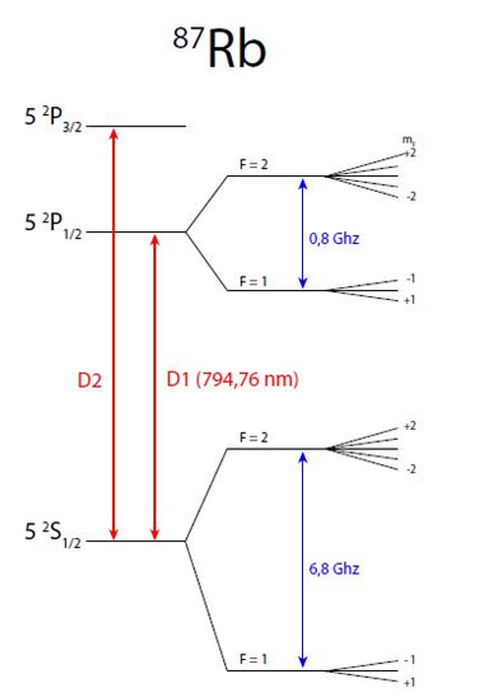
Problem of the day
Suppose that a laser field,
is applied to Rb atoms to drive a transition
from |5S_{1/2}, F, mF) to |5P_{3/2}, F’, mF’).
Find the Rabi frequency.

Slide 3
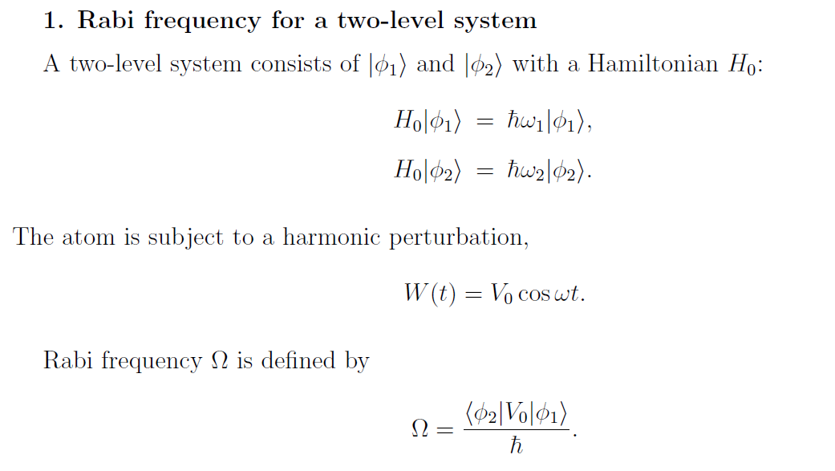

Slide 4
Suppose that a laser field,
is applied to Rb atoms to drive a transition
from |5S_{1/2}, F, mF) to |5P_{3/2}, F’, mF’).
Find the Rabi frequency.

Slide 5
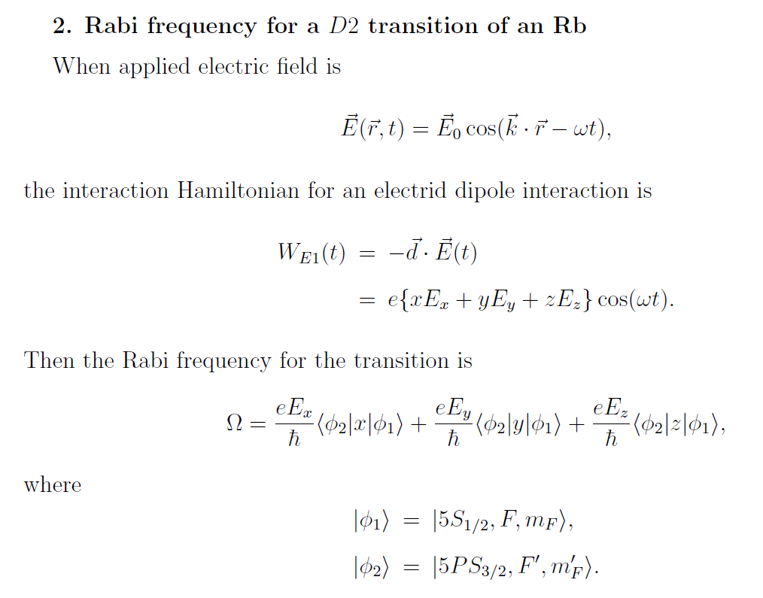

Slide 6
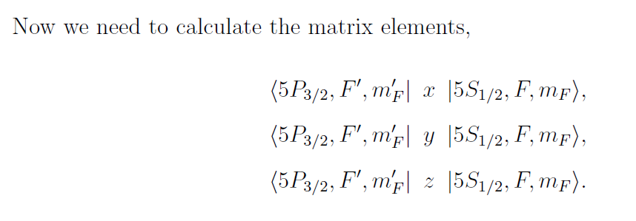
The issues are:
While the operators are x, y, and z, integral is over r, θ, φ.
There are three similar calculations.
The operator x, y, and z act on only L, not on S and I.

Slide 7
3-1. The simplest nontrivial case
Find W(t) and the Rabi frequency.

Slide 8
3-1. The simplest nontrivial case
Find W(t) and the Rabi frequency.

Slide 9
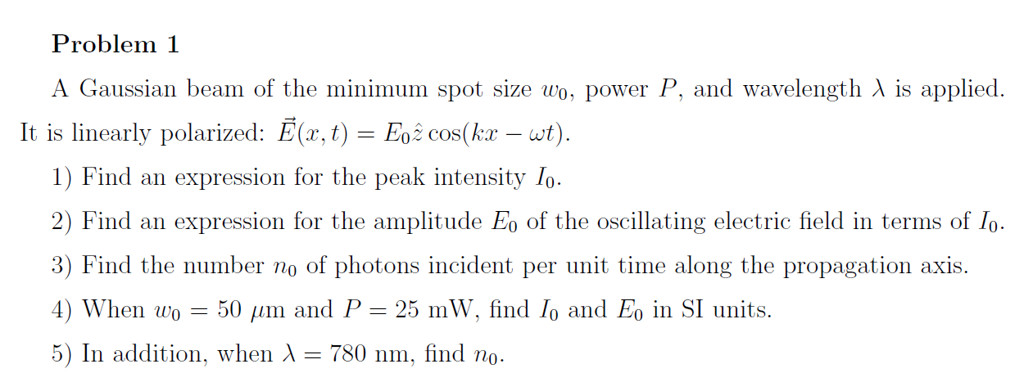

Slide 10
3-2. The next nontrivial case
Find the Rabi frequency.

Slide 11
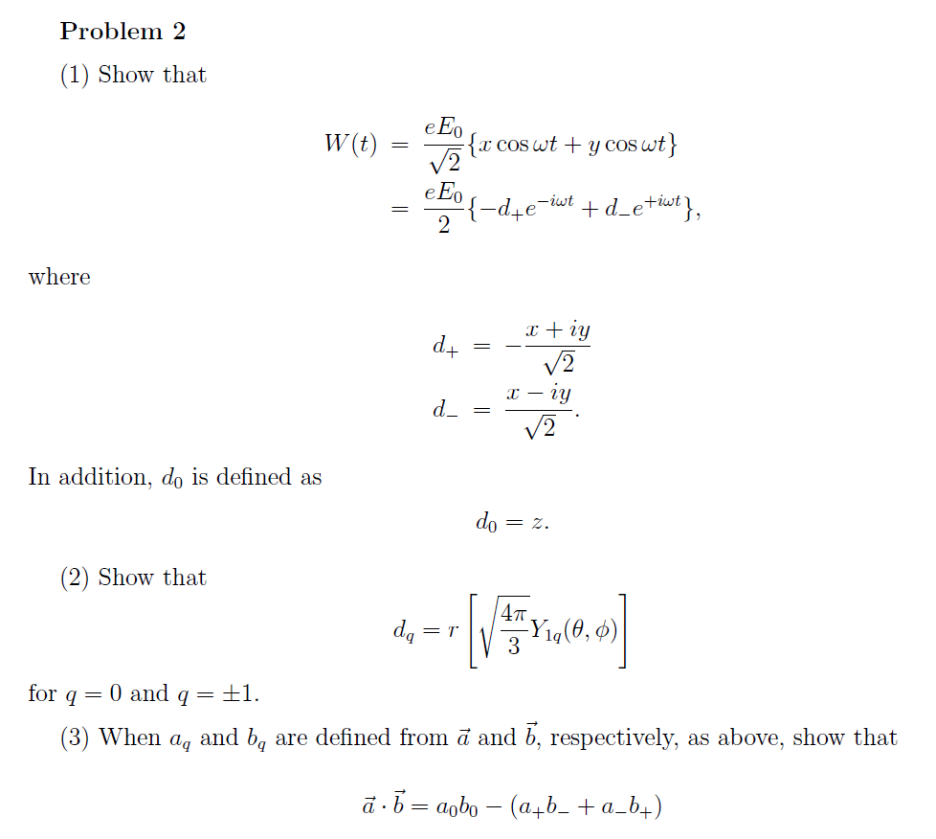

Slide 12
3-2. The next nontrivial case
Find the Rabi frequency using

Slide 13
3-2. The next nontrivial case
Find the Rabi frequency.

Slide 14
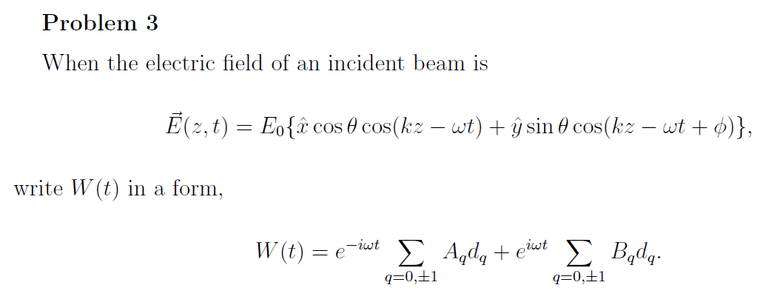

Slide 15
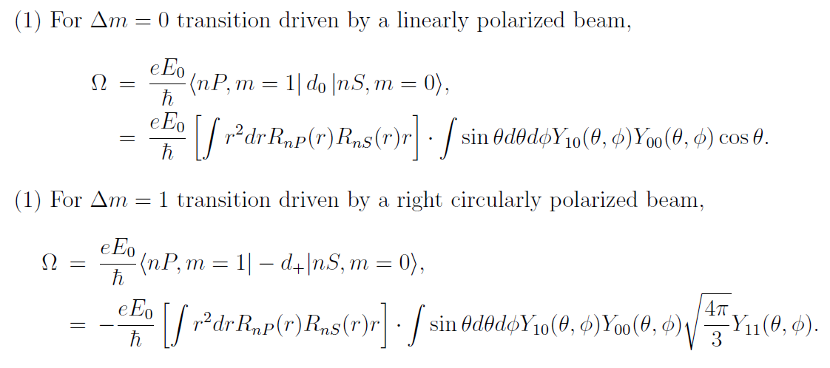
4. Wigner-Eckart theorem

Slide 16
4. Wigner-Eckart theorem

Slide 17
4. Wigner-Eckart theorem

Slide 18
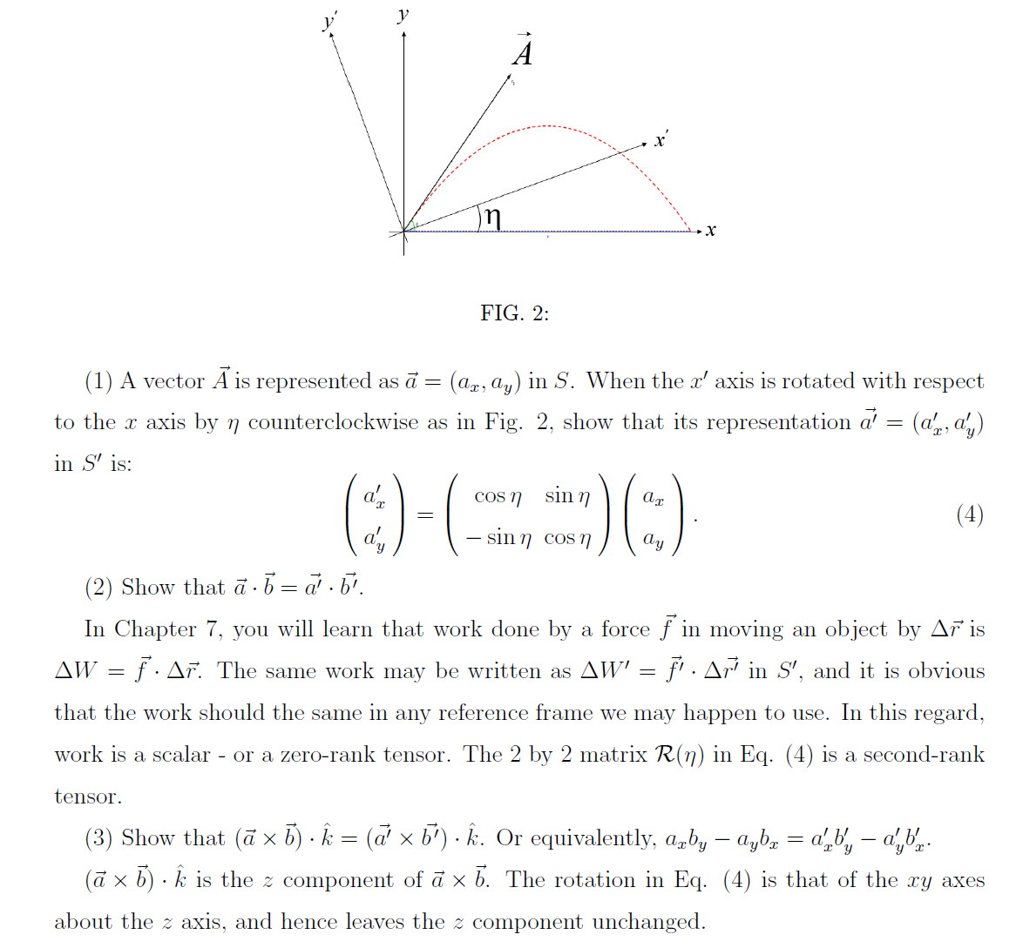

Slide 21
5-1. Wigner-Eckart theorem for LS-coupled states
Suppose that a laser field,
is applied to Rb atoms to drive a transition
from |5S_{1/2}, F, mF) to |5P_{3/2}, F’, mF’).
Find the Rabi frequency.
We need to evaluate
where d_{q} applies only to L.

Slide 22
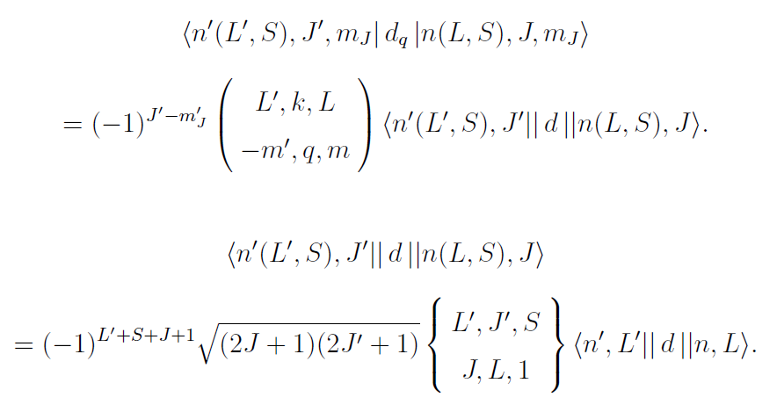
5-1. Wigner-Eckart theorem for LS-coupled states
We need to evaluate
where d_{q} applies only to L.

Slide 23
5-2. Wigner-Eckart theorem for (LS)JI-coupled states
Suppose that a laser field,
is applied to Rb atoms to drive a transition
from |5S_{1/2}, F, mF) to |5P_{3/2}, F’, mF’).
Find the Rabi frequency.
We need to evaluate
where d_{q} applies only to L.
We need to evaluate
where d_{q} applies only to L.

Slide 24
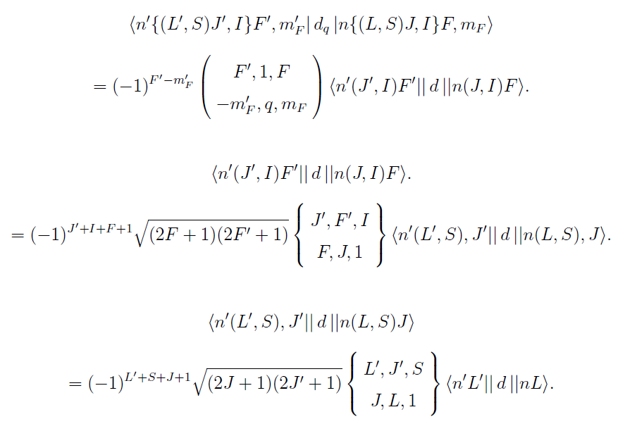
5-2. Wigner-Eckart theorem for (LS)JI-coupled states

Slide 25
In summary,
Now, we need to evaluate the reduced matrix element,
e.g., for 87Rb D2 transition, |<..>| = 4.17ea₀ from above,
while tabulated value is 4.23 ea₀.

Slide 27
